Slide 1
Operating System
Unit 4
Protection and Security

Slide 2
Security
Security in an operating system refers to the measures and processes that are put in place to protect the system and its data from unauthorized access, modification, or destruction.
The primary goal of OS security is to maintain the confidentiality, integrity, and availability of the system and its resources.

Slide 3
CIA Traid
In the context of Operating Systems (OS), the three pillars of information security are:
Confidentiality
Integrity
Availability

Slide 4
Integrity
This refers to the accuracy, completeness, and consistency of data.
In an OS, integrity ensures that data is protected from unauthorized modification or destruction.
This is typically achieved through access control mechanisms, such as permissions, which limit who can modify or delete data.

Slide 5
Confidentiality
This refers to the protection of sensitive information from unauthorized access.
In an OS, confidentiality is achieved through encryption, access controls, and other security measures designed to prevent unauthorized access to data.

Slide 6
Availability
This refers to the accessibility of data and resources when they are needed.
In an OS, availability is achieved through redundancy and fault tolerance measures, such as backups and failover systems,
which ensure that data and resources are always available even in the event of hardware or software failures.

Slide 7
Need of Security
Protecting against unauthorized access: An OS should prevent unauthorized users from gaining access to the system or its data. This is important to ensure that sensitive information such as personal data, financial data, and intellectual property is not compromised.
Preventing malware and viruses: An OS must be equipped with security features to detect and prevent malware and viruses from infecting the system. Malware and viruses can cause damage to the system, steal data, or allow unauthorized access to the system.

Slide 8
Need of Security
Ensuring data confidentiality: An OS should provide security features to ensure the confidentiality of data stored on the system. This can be achieved through encryption, access controls, and other security measures.
Protecting against denial-of-service attacks: An OS should be able to detect and prevent denial-of-service attacks, which can overload the system and prevent legitimate users from accessing it.
Ensuring system integrity: An OS must be designed to protect against unauthorized modifications to the system files and configurations. This helps ensure that the system operates as intended and prevents unauthorized access or data loss.

Slide 9
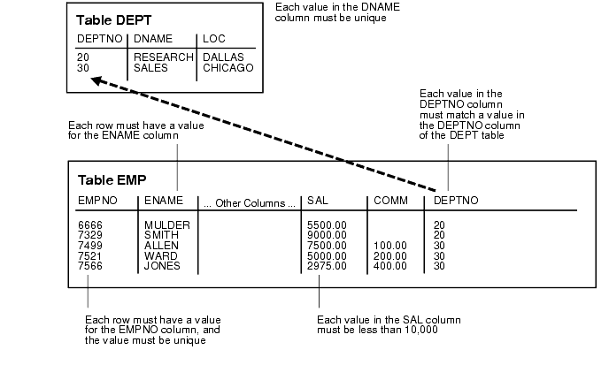
Data Integrity Example

Slide 10
Security Vulnerabilities
Security vulnerabilities refer to weaknesses or flaws in software, hardware, or network systems
that can be exploited by attackers to gain unauthorized access to sensitive information, or cause other malicious activities.
Buffer overflow
Trapdoors
Backdoors
Cache poisoning

Slide 11
Buffer overflow
A buffer overflow vulnerability is a type of software vulnerability that occurs when a program or application tries to write more data into a buffer or memory location than it can hold.
This can lead to overwriting adjacent memory locations, which can cause the program to crash, behave unpredictably, or even allow an attacker to execute arbitrary code.
Buffer overflows can be prevented through various techniques, such as input validation, bounds checking, and secure coding practices.

Slide 12
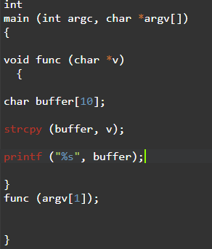
Stack buffer flow example

Slide 13
Backdoor
A backdoor in an operating system is a secret method of bypassing normal authentication and gaining unauthorized access to a computer system.
Backdoors can be created by developers for debugging or testing purposes, but they can also be inserted maliciously by hackers or malware.
A backdoor is a secret or hidden entry point into a system that is intentionally created by someone with access to the system, such as a software developer or system administrator.
Backdoors can be a serious security threat because they allow attackers to gain access to systems without being detected.
Once a backdoor is installed, attackers can use it to steal data, install malware, or perform other malicious activities.

Slide 14
Trapdoors
A trapdoor, on the other hand, is a hidden entry point into a system that is often created unintentionally as a result of a software bug or vulnerability.
Unlike backdoors, trapdoors are not intended to provide access to a system and are often unknown to the system administrator or developer.
If a trapdoor is discovered by an attacker, it can be exploited to gain unauthorized access to a system.
Example: Default passwords

Slide 15
Cache Poisioning
Cache poisoning is a type of cyber attack in which an attacker exploits vulnerabilities in a DNS server to divert traffic from legitimate websites to malicious ones.
This is done by modifying the DNS cache of the server, which is used to store the IP addresses of frequently accessed websites.
DNS cache poisoning works by injecting false information into the DNS cache, such as false IP addresses for legitimate domain names.
This can cause a user's web browser to connect to the attacker's website instead of the legitimate one, allowing the attacker to steal sensitive information or distribute malware.

Slide 16
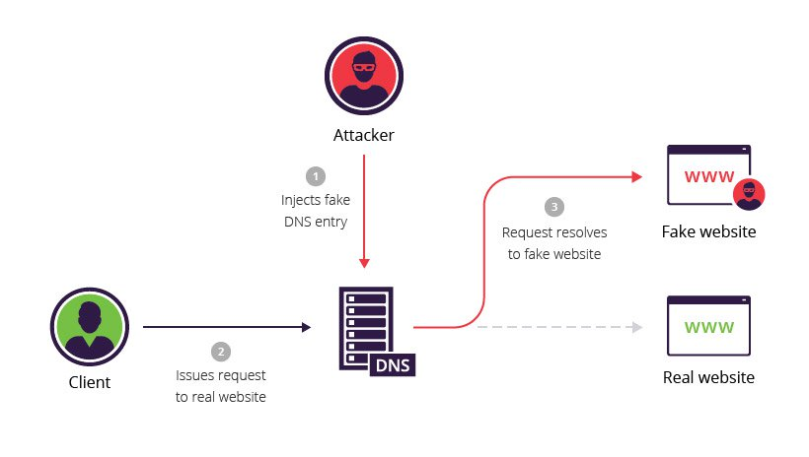
Cache Poisoning

Slide 17
Security Measure Levels
To protect our system, we must take security measures at 4 levels:
Physical - Secure Hardware Components
Human – Use Passwords for protection
Operating system – Use Valid Login and Password
Network – Use authentication and anti-virus to protect data/ resources over the network.

Slide 18
Security Measure Levels
To protect our system, we must take security measures at 4 levels:
Physical - Secure Hardware Components
Human – Use Passwords for protection
Operating system – Use Valid Login and Password
Network – Use authentication and anti-virus to protect data/ resources over the network.

Slide 19
Program Threats
Writing a program that creates a breach of security or causing a normal process to change its behavior and create a breach is the common goal of crackers
Malware: A destructive program that pretend to be a gentle application.
A back door is a means of access to a computer program that bypasses security mechanisms.

Slide 20
Trojan horse
A Trojan horse, or Trojan, is software that appears to perform a desirable function for the user, but steals information or harms the system.
Trojan horse is a program in which harmful code is contained in such a way that it can get control and do its chosen form of damage

Slide 21
Spyware
A software that secretly monitors the user's computing.
Spyware is a type of malware that can be installed on computers, and which collects small pieces of information about users without their knowledge.
The presence of spyware is typically hidden from the user, and can be difficult to detect.
Sometimes, Spywares are installed by the owner of a shared, corporate, or public computer in order to secretly monitor other users.

Slide 22
Trap Door
The designer of a program or system might leave a hole in the software that only designer is capable of using. This type of security breach is called trap door.

Slide 23
Logic Bomb
Under normal operations, there would be no security hole. However, when a predefined set of parameters was met, the security hole would be created. This scenario is known as a logic bomb.

Slide 24
Stack and Buffer Overflow
The stack- or buffer-overflow attack is the most common way for an attacker outside the system, on a network or dial-up connection, to gain unauthorized access to the target system.

Slide 25
6. VIRUS
Fragment of malicious code embedded in a genuine program.
designed to “infect” other programs.
Specific to architecture, operating systems and applications.
Needs human intervention to move from host to host.
Needs some one to actually take that program from one device and run it onto other device
Does not self replicate itself

